Slide 1
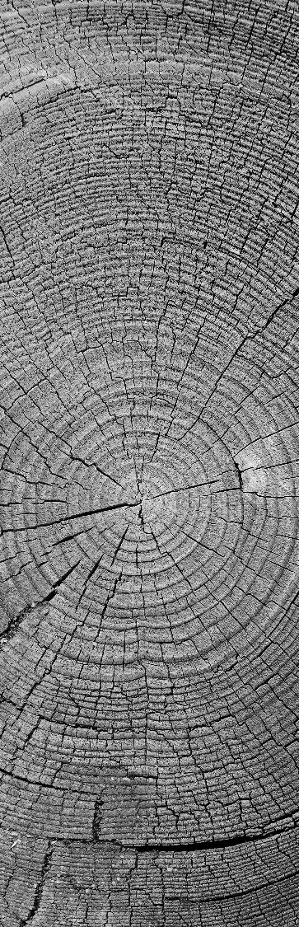
Gridding and Optimization for a Drone Swarm
The National Institute of Engineering Mysore
Adithya Sanjeev B
Prathvi Rao
Sanjana Raj

Slide 2
Introduction
The Big Picture

Slide 3
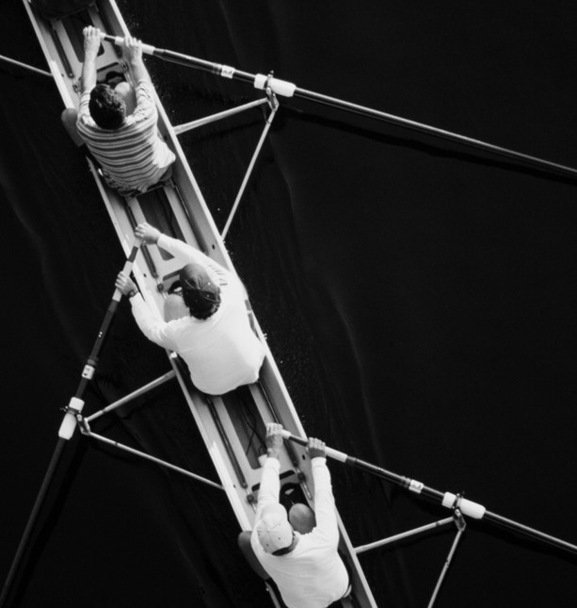
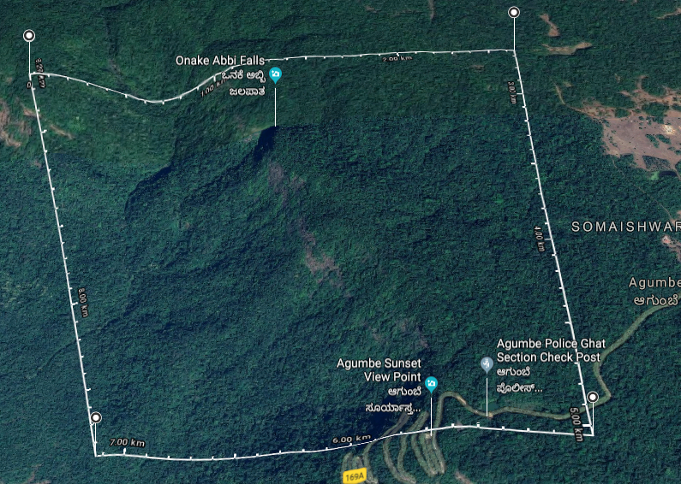

The aim of the integrated project
Goal is to complete a mission by navigating autonomously and share vital information.
The main purpose of the these drone is to scout the disaster areas or inaccessible terrain areas and report with the relevant data to the Cloud Data Centre for any analytics and processing.

Slide 4

Gridding
Recap to the previous work done

Slide 5


Previous Implementation
The algorithms used previously for dividing the master gird
Area Division
Line Division

Slide 6

Updated Literature Survey
New Survey for the upcoming algorithm
Fibonacci Series: https://www.springer.com/cda/content/document/cda_downloaddocument/9783642309632-c1.pdf?SGWID=0-0-45-1341610-p174534088
Harriss Spiral: https://www.theguardian.com/science/alexs-adventures-in-numberland/2015/jan/13/golden-ratio-beautiful-new-curve-harriss-spiral
Polygon division using centroid: https://owlcation.com/stem/How-to-Solve-Centroids-of-Compound-Shapes
Adding Distances to LatLong coordinates: https://stackoverflow.com/questions/7477003/calculating-new-longitude-latitude-from-old-n-meters

Slide 7
Updates on the line division algorithm
There is a need to further update the said algorithm for the following reasons:
Lot of assumptions in calculating the minimum coverage area of each drone
Min area depends on the value of “n” (Constant) and power of the drone. This would usually be different for each drone in reality.
Due to this, the value of “n” is not a fixed value for all drones
Further optimization needs to be done in calculation used to calculate the value of said “n”

Slide 8

The new algorithm
Based on the Fibonacci and Harriss Spirals
Min area depends on is value of "n" and power of battery pack of each drone
This algorithm provides grids concentrated at the center where the anomalies are more likely to be present on the map

Slide 9
roadmap
Optimization of current algorithm
Generation of next algorithm
Compatibility of LatLong and distances
Comparison of all the Algorithms developed
Research paper

Slide 10
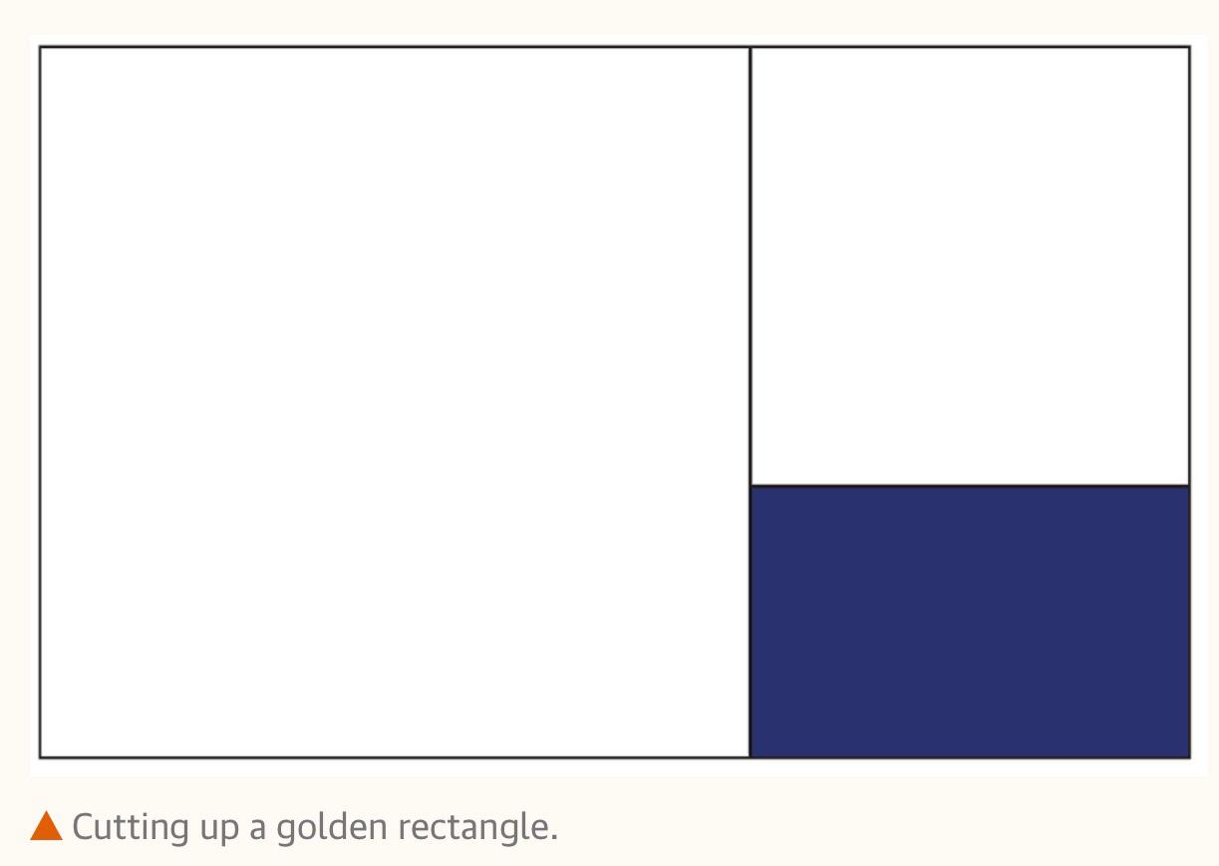
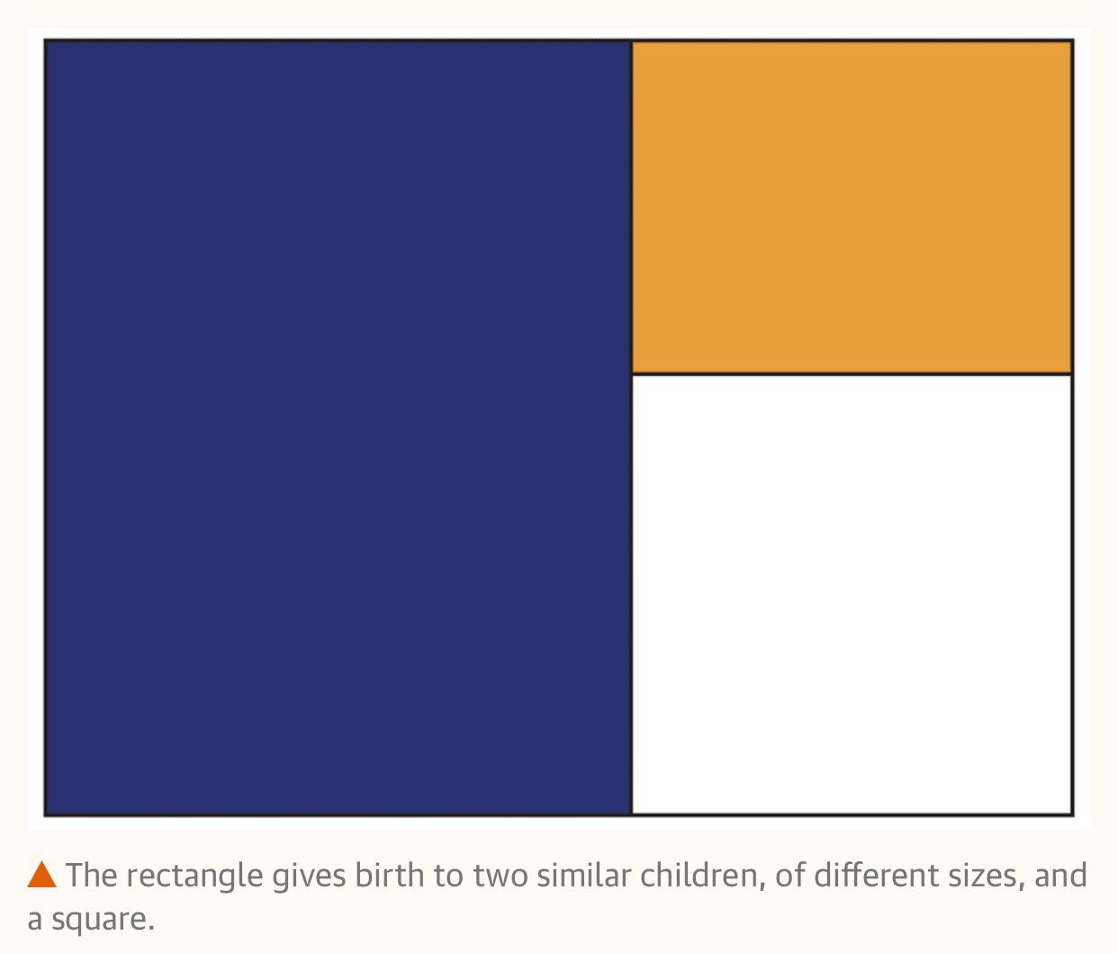
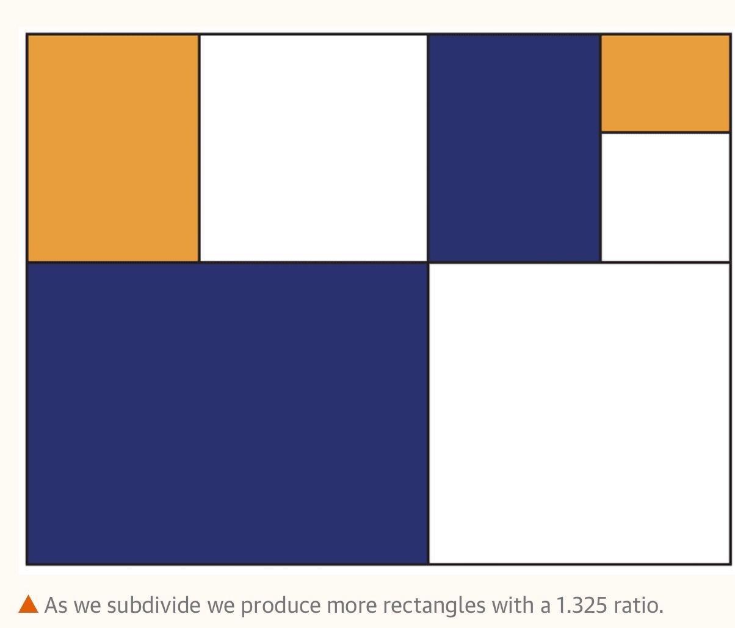
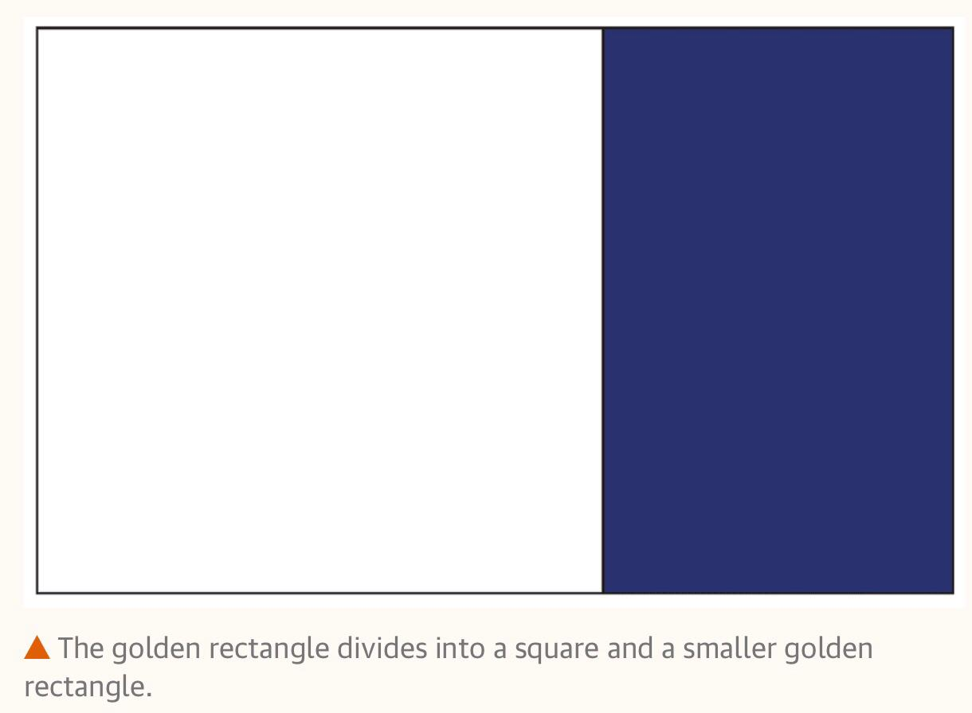
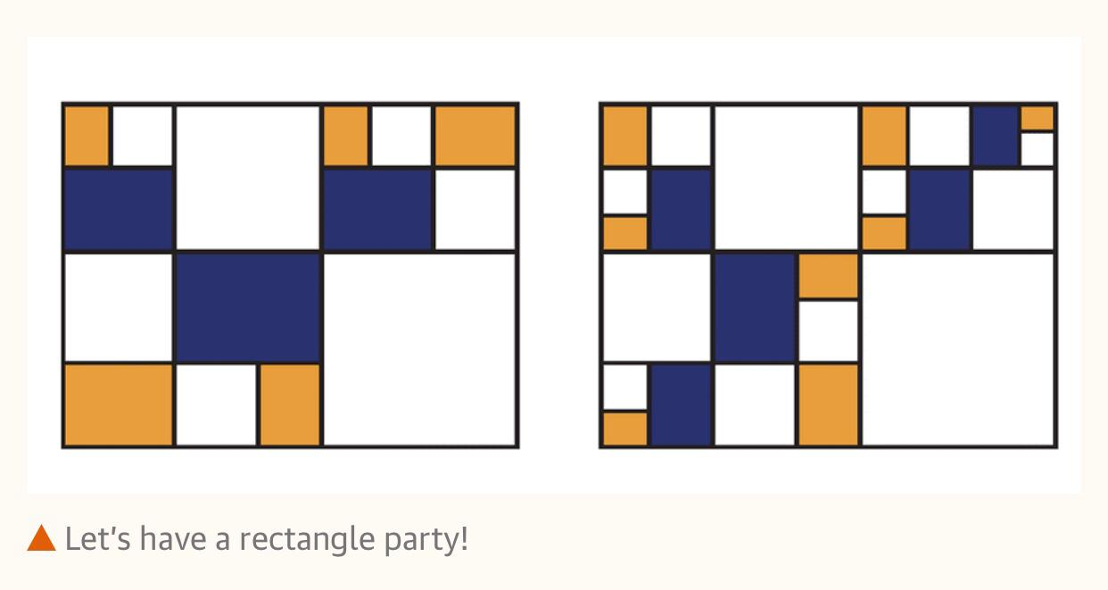
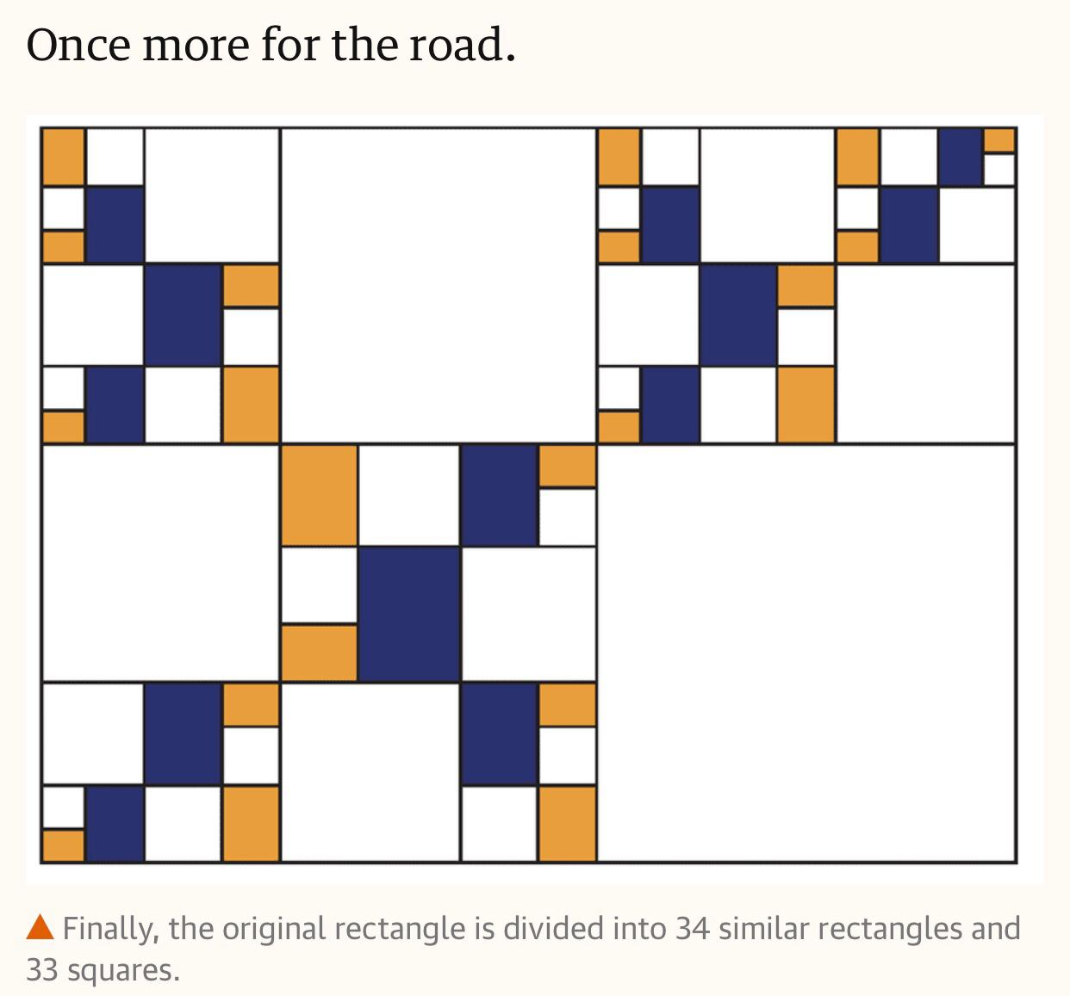
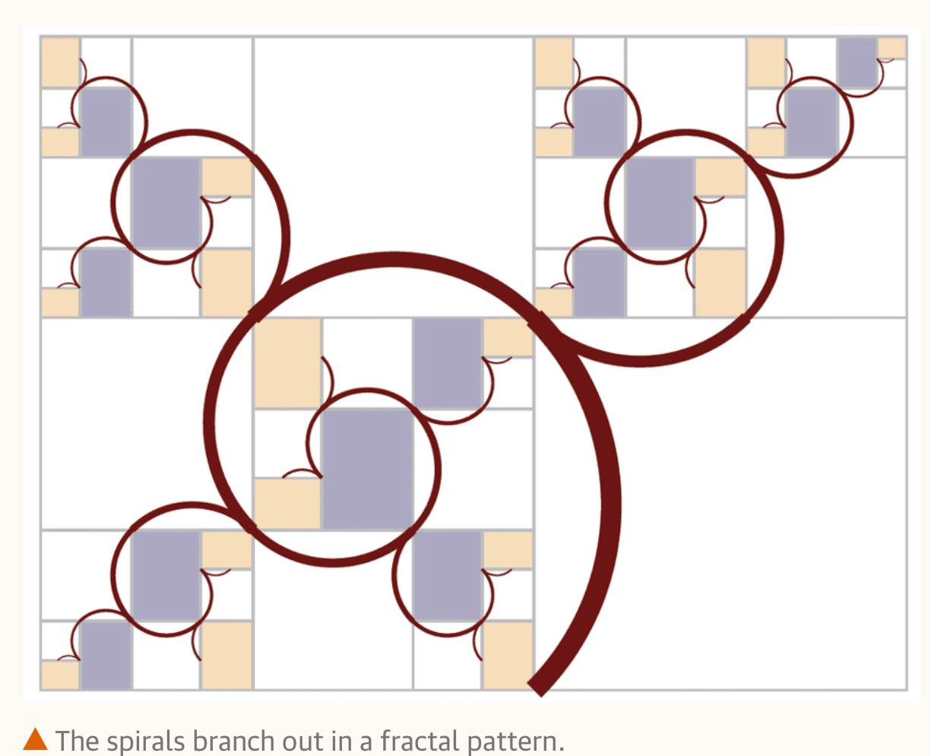
Generation of harriss spiral

Slide 11
THANK YOU
WOODGROVE BANK

